Slide 1





Destination Marketing Update
May 2024
Notes:
Welcome and introduction by Chris Hart, Chair of ERBID Co.

Slide 2



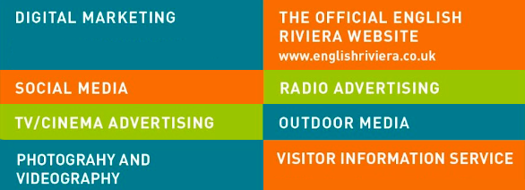
ERBID2
Business Plan
Notes:
Presenter: Carolyn Custerson
Each BID is for 5 years and this is the second BID operated by the ERBID Company, with our focus on providing professionally coordinated Destination Marketing to attract new visitors all year round.
The official Visitor Brand is English Riviera.
Every activity is evaluated to ensure that we achieve the highest ROI possible for you as Levy Payers.
In total we invest around £400k in Marketing Activities plus £100k pa in Event development and promotion. £500k pa in total.
Today we will share with you the activities we are undertaking in 2024.
The next BID Ballot will be in the summer of 2026 and will determine if there is an ERBID3 and another 5 year term marketing the resort.

Slide 3

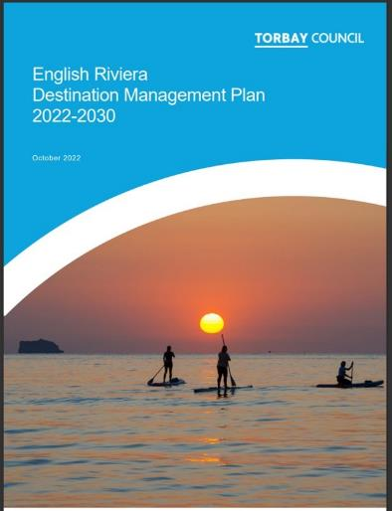




English Riviera
Destination Plan - 2030
Destination Development | Market Relevance
Food & Drink | Cultural Explorers Young Actives Conference & Meetings
Watersports | Fun by the Sea Families Young Actives
Geopark | Young Actives Cultural Explorers Fun by the Sea Families
Culture & Events | All segments (event specific)
Notes:
Presenter: Carolyn Custerson
The Destination Management Plan (DMP) works alongside and supports the ERBID2 Business Plan
Strategic objective of the DMP is to grow back our Visitor Economy post COVID and is a joint plan of action up to 2030.
COVID caused us a lot of damage and we have not got back to pre-COVID levels of visitor numbers and spend yet.
Key growth markets include Young Actives (friends and couples in their 20’s and 30’s) and Cultural Explorers couples or groups and friends typically 35+ take several breaks a year.
Successes so far include securing funding from the UK Shared Prosperity Fund which has directly impacted destination marketing, with new Geopark Discovery Experiences launched this year.
Also recognition of SUP as future growth potential.

Slide 4

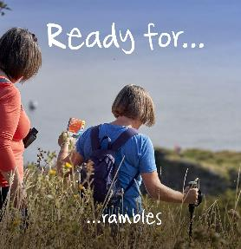
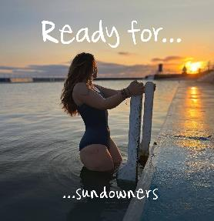

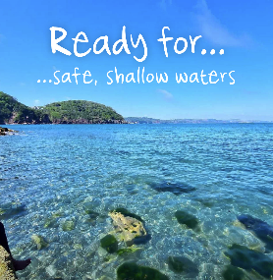
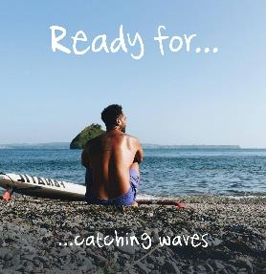
2024
Marketing Themes
On the Water
Nature
Culture
Food & Drink
Relax
Notes:
Presenter: Carolyn Custerson
5 new Digital targeted Marketing Themes for 2024 - inspired from the DMP
The Strategic Objective is to raise the profile of the resort other than just a traditional seaside destination
And to attract new first time visitors year-round.

Slide 5

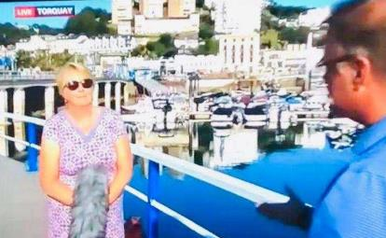
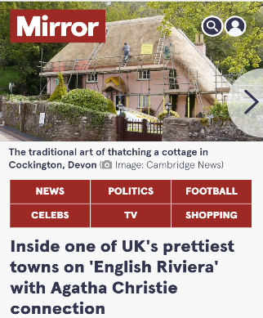
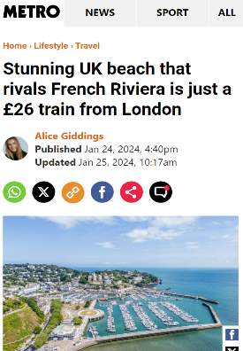
Appointment of FOUR
National PR Agency
#EnglishRiviera
Importance of branding
Dedicated spokespersons
Press Releases
Press Visits
Notes:
Presenter: Carolyn Custerson
Appointment of FOUR - a high profile National PR Agency to Strengthen the Resort’s Profile & generate positive messaging to national media
Dedicated Spokespeople to be appointed with a PR Tool Kit so everyone stays on brand
National coverage to be shared with Levy Partners

Slide 6

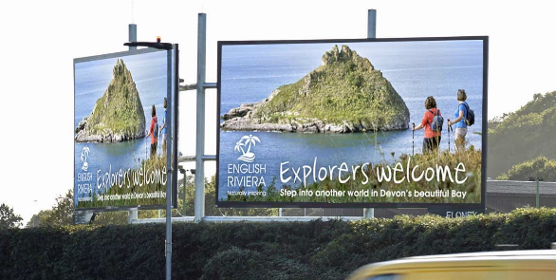

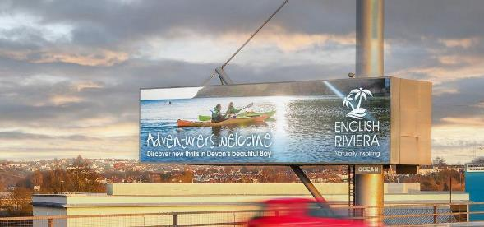
National Advertising
Notes:
Presenter: Carolyn Custerson
Repeating the success of previous roadside poster campaigns, 2 campaigns invested in for 2024: Family Market being targeted in Birmingham and new ‘growth’ markets targeting Cultural Explorers and Young Actives in Bristol.
Important that we position ourselves to offer more than traditional family seaside holidays and target the growth markets identified in the Destination Management Plan to diversify our visitor base.
We always see a significant spike in website traffic when we carry out these national marketing campaigns, but they are expensive.
We always underpin the poster campaigns with Digital Campaigns.

Slide 7


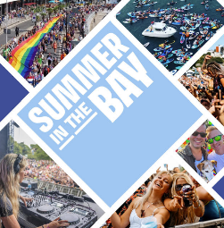
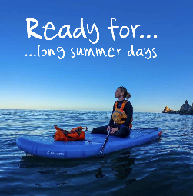

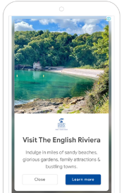
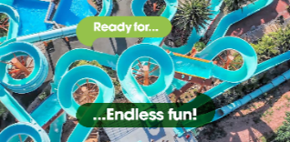
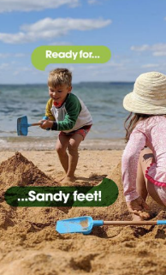

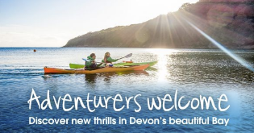
Digital Campaigns
Paid digital running throughout the year
Four main campaigns:
‘Always On’
Summer Family
What’s On
The “Big 5”
Aims: to extend the season and attract new visitors whilst aligning with the DMP.
Notes:
Presenter: Gina Franchi
Intro: Hello, I’m Gina, I’m a freelance Digital Marketing Specialist and I’m going to talk about the ERBID digital activity today.
Working with professional digital agencies, the ERBID invests in paid digital campaigns to accurately target specific markets. These are the campaigns that you don’t see, which might seem strange - but we exclude the bay from our campaigns so we get better Return On Investment. However, as a team, we prepare a monthly marketing report that details all the activity we do, which go out on our monthly B2B newsletters so you can see what we’re up to - if you don’t receive these newsletters, please speak to us after.
There are 4 main campaigns this year:
“Always On” This campaign runs all year, on Google Display & Google Search. This is a general destination campaign, which targets those with relevant interests or are searching certain terms.
Summer Family - this is our key family summer campaign. The main tagline for this is “Ready for the Riviera” and the main creatives are the family on the beach. This campaigns are on Meta, (Meta is the company name for Facebook and Instagram) and Google Performance Max - which is a range of ads across Google platforms e.g. Gmail, Google Display, YouTube etc. This campaign runs from March - July, and targets families in Birmingham, Wolverhampton and Coventry.
What’s On - this campaign showcases the range of events we have here and aims to attract new visitors to the area. It runs from April - September and targets Bristol, Cardiff, Buckinghamshire and Hertfordshire. This campaign is on Meta only.
The “Big 5” - as Carolyn mentioned, these are Culture, Nature, Water, Food & Drink and Relax. The aim of these campaigns are to extend the season and attract new visitors whilst aligning to the growth markets identified in Destination Management Plan. These are running slightly staggered throughout the year. They are on Meta only, targeting Bristol, Cardiff, Bucks and Herts on. Alison will send you an email with the creatives, copy and details about the campaign shortly.
All campaigns have a dedicated landing page on the website, which reflects the campaign creatives and content that is targeted for the user e.g. the family one features family attractions, the Relax campaign in the Big 5 features spas, the Water one features boat trips etc.
Last year, we reached over 20 million people from digital campaigns.

Slide 8


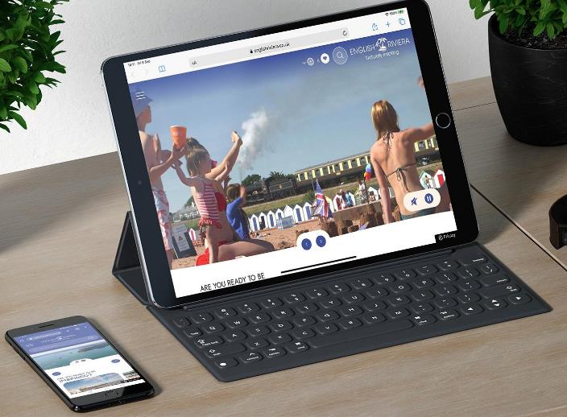
Website
1 million
Users each year
£75k
Invested each year
2,500
Pages of content
Notes:
Presenter: Gina Franchi
The main marketing resource of the ERBID is the English Riviera website.
1 million users: each year, there are 1million users on the website. This outperforms many other destinations.
£75k each year is invested in the operation of the website. This includes professional SEO, support and benchmarking against other destinations.
We continually update and improve the website. Just this year, we have updated 3 areas of functionality to make it even easier for users,
Firstly clearer search functions, helping users find their way around the website.
Secondly, the introduction of guest blogs - these are free and available for anyone to write about - if you have something interesting to write about the Bay, please do come and speak to me after and we can arrange something.
Thirdly - the introduction of “sticky buttons” on your own business page, your website and phone number is now clearer and easier for users to click on as it follows you down the page, hopefully sending more traffic to your own site.
There is constant monitoring of website performance via GA4, Microsoft Clarity and SEO reports.
And Constant updates and checking on content from the whole ERBID team across the 2,500 pages on the website.
The English Riviera website has significant google authority. Every BID partner has their own page, with redirects to your own site. As the English Riviera website is highly ranked by Google, having their referrals to the official English Riviera website will help you with your own Google Authority.
The website is split into main level one pages, which reflect the sectors in the Bay including Accommodation, Food & Drink, Things To Do and What’s On. It then filters down into smaller level 2 pages which are great for SEO.

Slide 9

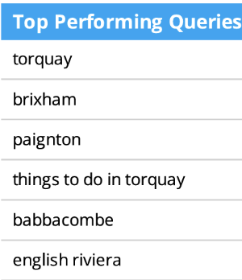
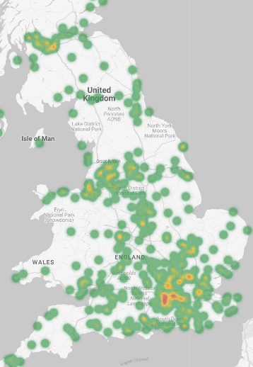

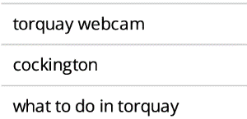
Website Insights
70%
Users are on mobile
25-34yo
The largest
age bracket
Torquay & Brixham
Things To Do
What’s On
Top 10 Beaches
English Riviera Webcams
Most popular topics on the
website in 2023
Notes:
Presenter: Gina Franchi
To help with your own marketing, here are some insights into the English Riviera website users.
All of these stats are for the whole 2023 year.
Locations: good split around the country, with key hotspots including Birmingham, Bristol, Cardiff and London. However many servers are based in London, so this will skew the data. Most websites will have London as their number 1 location which isn’t accurate.
Mobile: hopefully everyone is aware that the majority of website users are now on mobile. On the English Riviera site, 70% of users are on mobile. So it’s really important that your website is built mobile first, or at least optimised for mobile.
Age: on the ER site has shifted in recent years. For 8 months of the year, 25-34 yrs old make up the largest age bracket visiting the website. Over the peak summer period, this switches to 34-44yr olds.
Topics: that consistently do well for organic traffic are Torquay & Brixham, Things To Do, What’s On, Beaches and Webcams. If you can create quality content around these topics, it is likely to help with your SEO.
Queries: and similarly, on the screen are the top performing google searches that brought traffic to the ER site in 2023. E.g. you might want to incorporate some of these terms into your site if appropriate. For instance, you could include the phrase “Thinking of What To Do in Torquay?”
It’s so Important to keep your own website up to date with quality content. Link in with events, culture, history, talk about the area - this is all SEO rich content - and as you’re writing, keep in mind what somebody might search that would lead to your website.

Slide 10



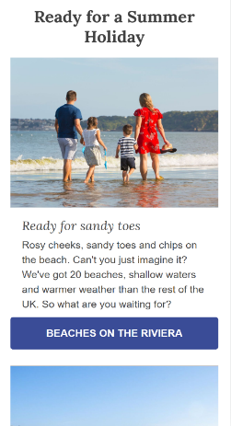
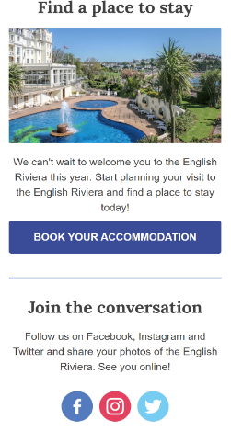

Consumer
Newsletters
3%
Av. Click Through Rate in 2023
33%
Av. Open Rate in 2023
Industry average open rate is 20.44%, and average click through rate is 2.25%.
Notes:
Presenter: Gina Franchi
There are over 30k subscribers to our main ER newsletter list
It was redesigned in 2023 to make even more inspirational
And optimised for top 10 email providers
We send out one email per month, following our yearly newsletter plan
Rates: both our open rates and CTRs are higher than industry average
Make sure you subscribe so you can see what’s going out to visitors

Slide 11

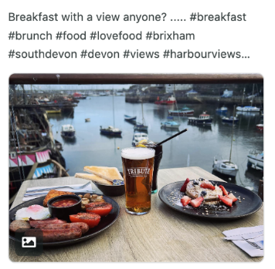



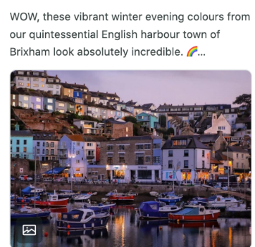

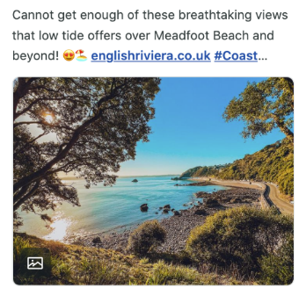
Social Media
Industry average engagement rates are between 1-5%. Ours are 3-6% depending on platform.
7.4m
People reached via organic social in 2023
Coastal
Brixham
Events
Aerial
UGC
Topics tend to get the highest
engagement across platforms
Notes:
Presenter: Gina Franchi
In 2023 we reached 7.4million people through organic social (i.e. no paid ad spend behind this).
This was through 5 different platforms: Facebook, Instagram, YouTube, TikTok and X (formerly known as Twitter)
TikTok is our newest platform, and we are actively growing this channel, primarily through using User Generated Content (or UGC) - content provided by anyone! I’ll talk more about this on the next slide.
Topics: the topics that tend to relate most to the audience are coastal, events, drones and UGC.
We are above industry average for engagement rates - we tend to average between 3-6% depending on platform, and the average is between 1-5%. This is because we test what content works best, and build on that, creating more content that we know our users will relate to.
We are also working alongside carefully selected influencers who have the engagement and authority in our target audience, linking these in with the 5 themes mentioned earlier.

Slide 12

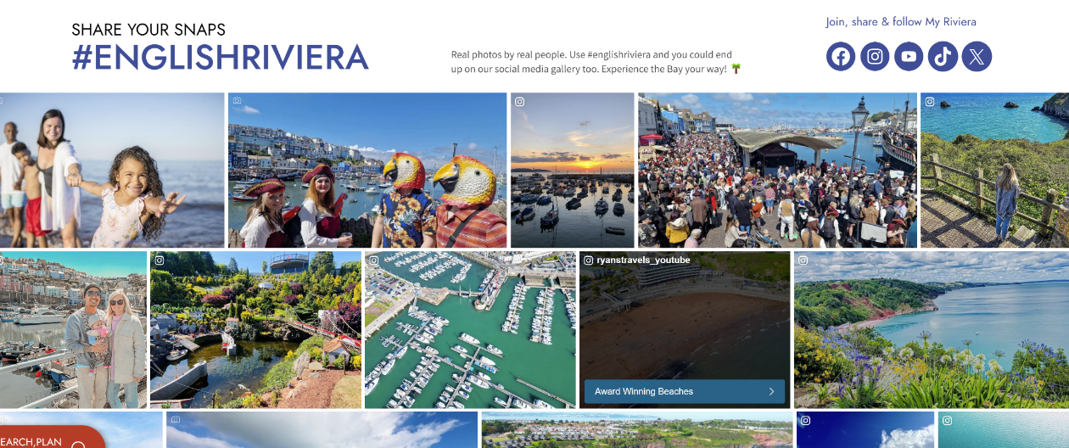
User Generated Content
Notes:
Presenter: Gina Franchi
Gallery: On the ER website, the eagle eyed among you may have noticed this “social media gallery”. These are real images, reels and videos that have been pulled in from social media platforms via a system called Crowdriff.
#EnglishRiviera: When someone uses the hashtag English Riviera, it will automatically get pulled into our Crowdriff.
It gets filtered through into topics using AI, and then Steve can select some, and automatically write a comment on their photo, asking for the ERBID company to have permission to use this photo in our marketing, after they read some T&Cs.
They reply using the #YesEnglishRiviera, and the ERBID company is allowed to use these images for destination marketing.
Unfortunately, these permissions only cover giving the ERBIDco marketing rights, we cannot pass these images onto levy payers.
Social: But the ERBID co can then use them on social platforms, on paid digital campaigns, newsletters, and printed materials
website: and can pull them directly into appropriate galleries on the website. We’ve set up around 50 different galleries, with topics on each town, watersports, wildlife, attractions, accommodation, dog friendly, seafood etc.
Buttons: We can also add buttons on these, so when a user hovers over them, it will link them to an appropriate page.
How can you get involved? Always tag #EnglishRiviera
For your best images, you can upload them directly into our Crowdriff account by going to our instagram, then clicking on the link in bio and “upload photos”. We’ll then get your high res images directly - its quick and easy to do from a phone.

Slide 13

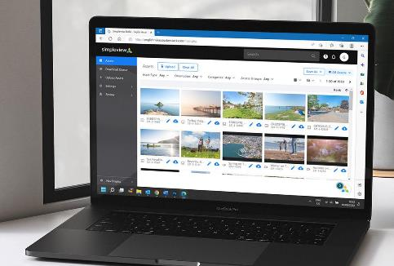

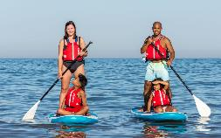
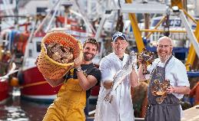
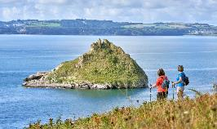
Image Library
Free access for all BID partners
Over 3000 copyright-free images and videos
Marketing toolkit for key events
Press / PR / advertising
Continued investment in new creative assets
englishriviera.barberstock.com
Notes:
Presenter: Alison Bayliss (ERBID Communications)
The image library is a free to use asset, created for all BID businesses to use. To log in or register for a free account, go to englishriviera.barberstock.com.
There are over 3000 high resolution, copyright free images and video clips to download - you can use these in your own business to promote the English Riviera.
We are working on improving the search functionality, with improved keyword searches. There is a category drop down - Hero Images is a good place to start.
For key ERBID-led events we now produce a marketing toolkit which we send by email - with a link to a collection of images, official logos, a suggested social media template and press releases. This is your ‘one stop shop’ to help you tell your visitors about what’s coming up.
Images are a vital resource for us to use for press enquiries, PR and in advertising.
Last year we commissioned Seafood Feast hero images and also undertook a new Walking Festival photoshoot which is also helpful for nature, cultural explorers and the Geopark.
This year we are planning an Airshow photoshoot and videoshoot to showcase the location, capture emotions (‘lifestyle’) and show the range of activities available.
We are always keen to find models and would like to better reflect the diversity of our community and visitors - please mention to family and friends
Again - log in or register for a free account at englishriviera.barberstock.com

Slide 14

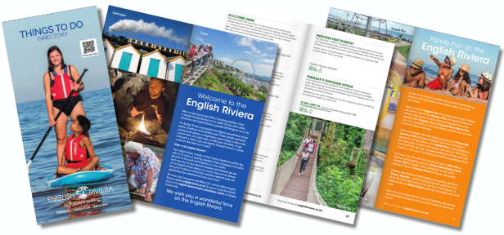
Printed Materials
Free publications to help showcase the English Riviera
NEW! TWO Accommodation Directories
Hotels, Guest Houses and B&Bs
Self-catering, Holiday and Camping/Touring Parks
Updated - Things to Do Directory
Updated - English Riviera A2 map
The Agatha Christie Mile…and More
Notes:
Presenter: Alison Bayliss
We produce a range of publications to support destination marketing. The demand for paper accommodation guides has been declining, however we still produce them and they are also available to view or download online.
New for 2024 - Accommodation: This year, we decided to split Accommodation listings across two directories - one specifically for serviced accommodation - hotels and B&Bs. The other specifically for self-catering, including holiday and camping parks. The reason for this is that previously, we couldn’t dedicate as much space to each property listing, particularly self-catering. We have been able to cover some of the cost of printing from advertising.
Updated - just arrived - Things to Do: We have just released a revised edition of the Things to Do Directory, again with advertising. This covers levy partners who are attractions, activities, and transport. It also includes beaches, parks and other helpful information.
‘Things to Do’ is one of the most visited sections of the website. Having amazing attractions, experiences and activities will attract visitors to the area, ahead of where they choose to stay.
Things to Do is picked up from the VIC, handy for visitors to have with them while in the resort.
A2 Maps: Similarly, very popular to be picked up by visitors in the VIC. Frequently posted out with other information. Popular with hotels. We are in the process of updating and having a new print run for this summer.
‘Agatha Christie Mile…and More leaflet’ - trail guide and map. Super popular, we get many requests, visitors pick up from the VIC. Supply to Agatha Christie Festival.
We can provide you with any of these publications to use in your own business - great for putting in self-catering information packs, leaving in guest bedrooms, keeping on reception or information tables.
All available on our website to view/download

Slide 15



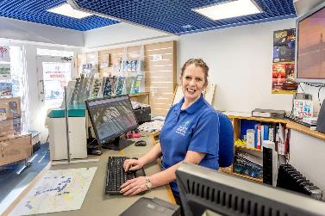
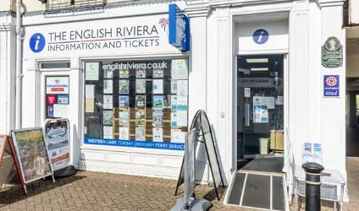
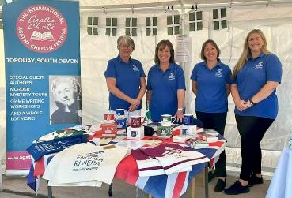
Visitor Information Centre
Open All Year - 7 Days Per Week.
Around 70,000 visitors
Top FAQ - Agatha Christie
Selection of travel books and Agatha Christie merchandise.
Meet and Greet for Cruise Ship Passengers.
Notes:
Presenter: Katrine Harrington (Visitor Information Manager)
Open All Year - 7 Days Per Week.
The Visitor Information Service has been awarded Visit Devon Gold and South West Tourism Excellence Silver Awards in this year’s awards.
Around 70,000 visitors use the service per year.
Top FAQ - Agatha Christie
We are the only local stockist of Half Moon (Agatha Christie merchandise).
Advertising opportunities for posters and website.
Assistance with updating complimentary website pages.
Meet and Greet for Cruise Ship Passengers.

Slide 16

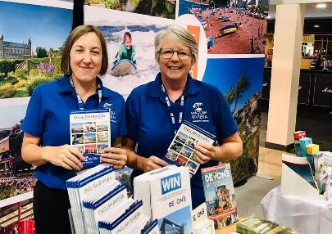
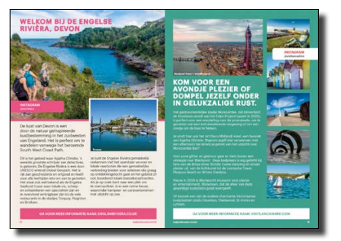
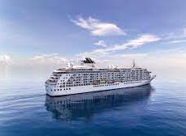
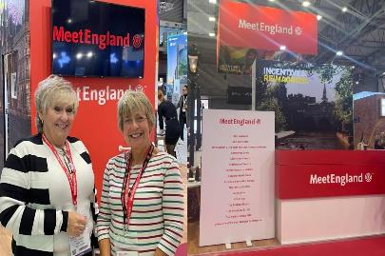
Special Projects
Groups Marketing
Conferences & Events
Cruise English Riviera
International Visitors
Notes:
Presenter: Carolyn Custerson
We continue to attend the British Travel Trade Show in Birmingham specifically targeting the Group Market which has seen an uplift since COVID. Working in partnership with Visit Devon means we can take a much bigger stand. We are a very popular destination for Group Holidays. The new hotels have provided us with more capacity and we have seen a significant increase in bookings from both domestic and international operators.
Rebuilding our shoulder season is really important and some good work is being done post-COVID to attract back more Business Meetings and Conference business. We work in partnership with Meet Devon and Meet England to reach this market organising FAM visits as required to try and secure the business.
We have invested in a dedicated Cruise English Riviera project to attract more ships to the Bay. This week our Cruise representative is in Stockholm meeting specifically with Tui and Princess Cruises. We have stiff competition from Plymouth and Dartmouth and the Cornish Ports, but there is a lot of interest in Agatha Christie and that is a big international hook for us.

Slide 17

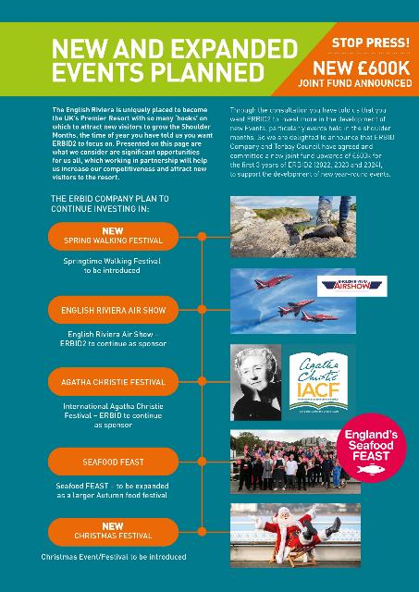








New Event Partnership:
£600k over 3 years
Notes:
Presenter: Carolyn Custerson
ERBID2 consultation reconfirmed the ask from businesses for more money to be invested in Events.
Which has happened with the ERBID Company ring fencing £100k every year of the BID to work in partnership with Torbay Council
Two new initiatives for ERBID2 include the new English Riviera Walking Festival and the Bay of Lights, specifically introduced to lengthen the season.

Slide 18
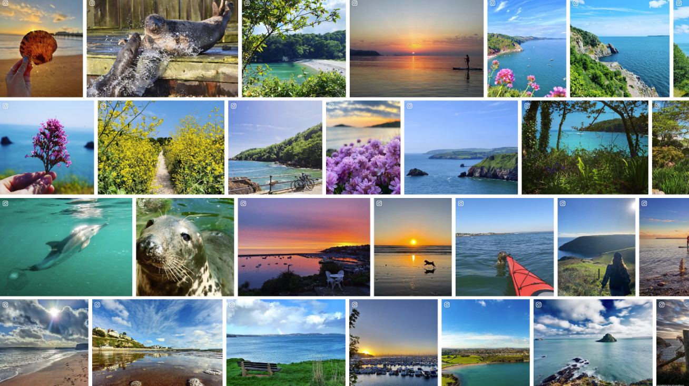

THANK YOU!
Thank you!
Q&As
Notes:
Q&As
So much more we could share with you – lobbying, government funding, LVEP launch, dev ERBID3 – what's next
The Q&A session to be followed by a talk from Rob Cox, CEO of Tudor Hotels Collection

